Slide 1
Oral History
A short introduction

Slide 2
What is it?
“….It begins with an audio or video recording of a first person account made by an interviewer with an interviewee (also referred to as narrator), both of whom have the conscious intention of creating a permanent record to contribute to an understanding of the past.”
- from Principles and best practices. (2009, October). Retrieved from the Oral History Association website at https://www.oralhistory.org/about/principles-and-practices-revised-2009/

Slide 3
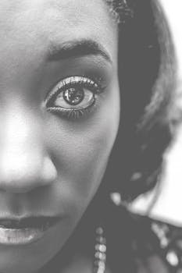
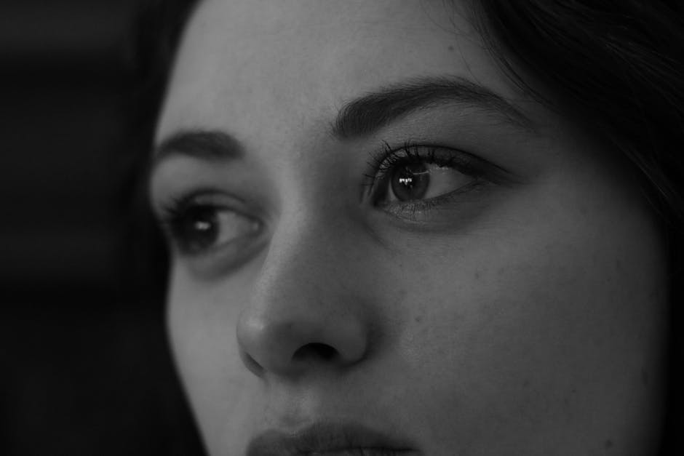
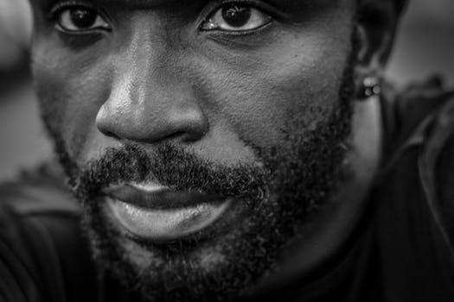
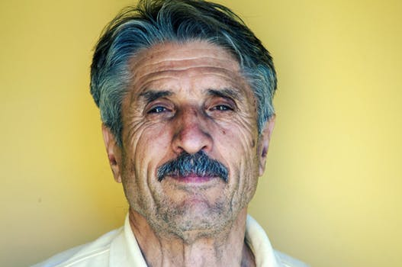
Point of view
Feelings, emotions
“Full range of life”
Capturing marginalized voices
(-Cited from Discovering oral history: What is it? (2012). Retrieved from Baylor University Institute for Oral History website at https://www.baylor.edu/content/services/document.php/66419.pdf)

Slide 4
Why do it?
“Oral history provides a fuller, more accurate picture of the past by augmenting the information provided by public records, statistical data, photographs, maps, letters, diaries, and other historical materials.”
- from Understanding oral history: Why do it? (2012). Retrieved from Baylor University Institute for Oral History website at https://www.baylor.edu/content/services/document.php/66420.pdf

Slide 5
Go to the “Oral History Resource Center of Durham” Website

Slide 6
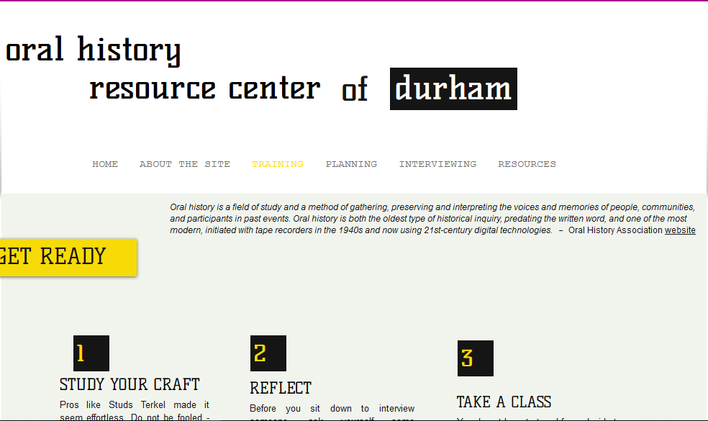
Click on the TRAINING Link

Slide 7
Scroll down under “Workshops and Classes” to see a list of readings and pre-workshop questions.

Slide 8
Workshop preparation
Go to the Training section of the course website: https://sltorian.wixsite.com/durhamoralhistory
Read the first two sections of the Baylor University, Introduction to Oral History manual
Discovering Oral History
Understanding Oral History
Complete the Pre-workshop questions on the website

